Slide 1
Data 606 Presentation: CHAPTER 2
Leticia Salazar

Slide 2

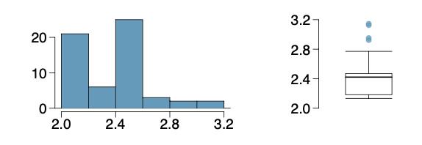
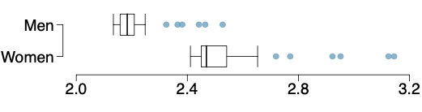
2.34 MARATHON WINNERS
The histogram and box plots below show the distribution of finishing times for male and female winners of the New York Marathon between 1970 and 1999.

Slide 3

2.34 MARATHON WINNERS
Questions:
(a) What features of the distribution are apparent in the histogram and not in the box plot? What features are apparent in the box plot but not in the histogram?
(b) What may be the reason for the bimodal distribution? Explain
(c) Compare the distribution of marathon times for men and women based on the box plot shown below.
(d) The time series plot shown below is another way to look at these data. Describe what is visible in this plot but not in the others.

Slide 4
(a) What features of the distribution are apparent in the histogram and not in the box plot? What features are apparent in the box plot but not in the histogram?
Histogram | Box Plot
Visual of number of people finishing at specific times and the decline over time | Summary of distribution and individual points
Two modes visible | Median is more visible
Right skewed | Notice the outliers!

Slide 5
(b) What may be the reason for the bimodal distribution? Explain
Data is displaying finishing times; the bimodal distribution is showing the outcomes for both male and female finishers.

Slide 6
(c) Compare the distribution of marathon times for men and women based on the box plot shown below.
Men’s finishing times are lower than the women.
Outliers for men end around 2.5
Outliers for women end closer to 3.2

Slide 7
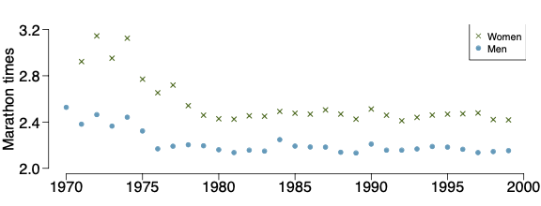
(d) The time series plot shown below is another way to look at these data. Describe what is visible in this plot but not in the others.
Clear visual way to represent the 2 data sets unlike the others
Other’s does not separate the men from women, nor does it show the years clearly.
Plot shows representation of men vs women times over 30 years
Over time, finishing times for both men and women decrease

Slide 8
THANK YOU!
QUESTIONS?

